Slide 1
Subject Report
Prepare a mail merge using the file NBA Reports Template.doc as your Master and the KS4 Subject Reports.xlsx as the source data.
You will need to insert relevant fields from your data source in to the master document (Refer to the next slide).
Proofread and spell check the subject comments.
Ensure the text formatting and spacing is consistent throughout the document.

Slide 2
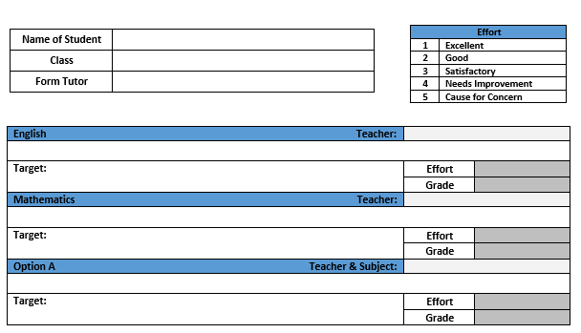
Subject Report
Insert Student Details
Teacher Name
Insert Subject Comment and Target for English, Mathematics and Option A.
Teacher and Subject
Effort and Grade

Slide 3
Term 3 Exam Grades
Prepare a mail merge using the file KS4 Term 3 Exam Grades.doc as your Master and the KS4 Grades T3.xlsx as the source data.
You will need to insert relevant fields from your data source in to the master document (Refer to the next slide).
Proof read the merge documents to see if the data matches up with the source document KS4 Grades T3.xlsx.

Slide 4
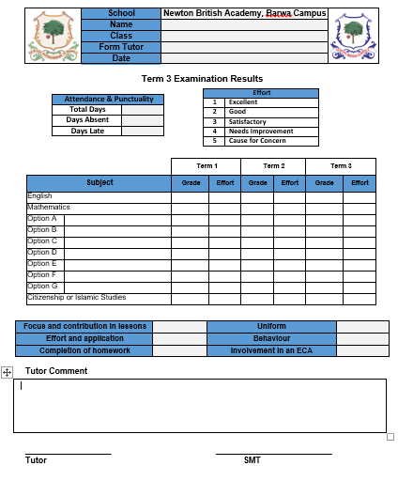
Term 3 Exam Grades
Insert Student Details
Insert Attendance & Punctuality Data
Insert date field
Insert Effort and Grade for each term
Insert Option Subject Names
Insert Pastoral data
Insert Tutor Comment

